Slide 1


COS801: Data Augmentation Approaches for Legal Document Analytics
Johann Pienaar - u24050505 Neacail Hilhorst - u16174977 Victor Dippenaar - u14221838
26 October 2022
‹#›

Slide 2



Introduction
Contracts are a fundamental part of society securing agreements between parties. Being able to automatically extract key values out of contracts can have the following benefits:
Legislative changes and imminent expiration of contracts are important elements that law firms communicate to their clients.
Agreed payments and deliverables are kept track of by contractors.
Law enforcement might flag contracts which pertain to certain parties, have a high contract value, or are defined by other features.
In our report we sought to replicate the experimental results reported in Chalkidis and Androutsopoulos (2017).
‹#›

Slide 3
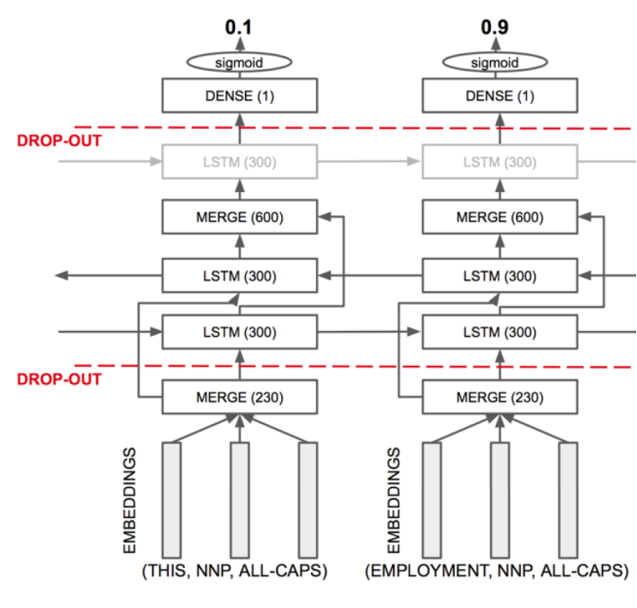
Extraction Approach
LSTM feature inputs:
Word embeddings
POS tag embeddings
Token shape embeddings
Not publicly available, generated own from hand crafted features.
Extraction Methods:
BILSTM-LR
BILSTM-LSTM-LR
BILSTM-CRF
Hyper Parameters:
Dropout Rate = 20%
Batch Size =
BILSTM-LR: 32
BILSTM-LSTM-LR: 32
BILSTM-CRF: 64/128
Pseudo zone extractor
20 tokens before and after the element
‹#›

Slide 4
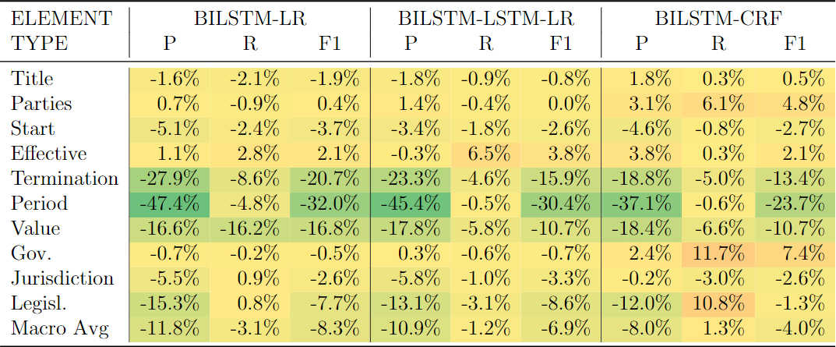
Results
Comparison of achieved results relative to the results obtained by the original authors. Negative values indicate improved performance.
‹#›

Slide 5
Results Summary
Improved macro averaged F1 score across all LSTM-based models.
BILSTM-LR: 8.3% BILSTM-LSTM-LR: 6.9%
BILSTM-CRF: 4.0%
Largest improvements to contract elements with fewer training data:
Termination date
Period
Contract value
Likely due to use of the pseudo zone element extractor and improved libraries.
POS tag embeddings lead to decreased model performance
Token shape embeddings:
Decreased BILSTM-LR and BILSTM-LSTM-LR model performance
Improved BILSTM-CRF model performance
‹#›

Slide 6
Conclusion and Future work
Given these findings, it would be recommended to train the BILSTM-LR and BILSTM-LSTM-LR models solely on the word embeddings, whereas it is recommended to train the BILSTM-CRF model on both word embeddings and token shape embeddings with a batch size of 64 for the start date, effective date, termination date, and contract value, and a batch size of 128 for the legislative reference
Future Work:
Enriching the label set by using a single classifier across contract elements.
Use of Data augmentation techniques for improving model training
Expansion to other non english languages(Expand on legalBert)
‹#›

Slide 7
Thank You

